Slide 1


PASSWORD STRENGTH-CHECKER
Blockchain and Cyber-Security

Slide 2
PASSWORD STRENGTH-CHECKER:
Presented By | Under the Supervision
GroupNo:1A | Dr.G.Sudhakar
1. S.Veena Akshaya - 2620090069 | Assoc.Professor
2. A.Sowgandhica-2620080045 | Dept-CSE
3. K.V.N.Brundha Geethika-2620080031 | Subject: DTIE-Projects
4. Lahiri-2620030399

Slide 3
Introduction
What is cybersecurity?
The practice of protecting digital systems, networks, and data from cyber threats and unauthorized access.
The three main goals of cybersecurity
Confidentiality: Ensures that only authorized people can access sensitive information.
Integrity: Protects data from being altered or tampered with.
Availability: Makes sure systems and data are accessible when needed.

Slide 4
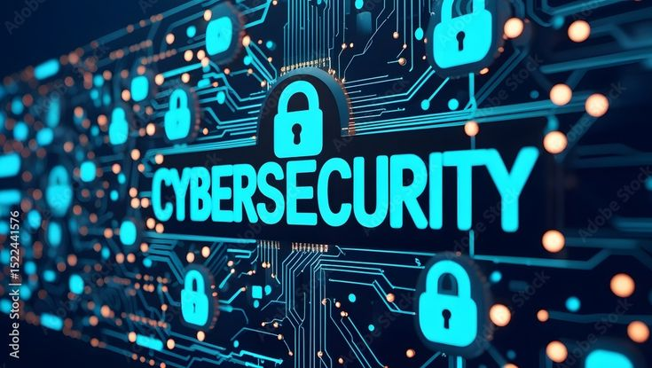
Why protecting digital information is important?
“Protecting digital information is important because it keeps personal data safe, prevents unauthorized access, and reduces the risk of cyberattacks and data loss.”
Protects personal data – passwords, photos, and important files.
Prevents financial loss – protects bank and payment information.
Prevents cyberattacks – reduces the risk of hacking, malware, and phishing.
Maintains privacy – keeps sensitive information confidential.
Maintains data integrity – prevents unauthorized changes to data.

Slide 5
Common Security problems
Weak passwords and data theft.
Fake messages or websites that steal information.
Easy-to-guess passwords can be hacked.
Unauthorized stealing of personal or business information.
Unauthorized access to systems or accounts.
Unsafe Wi-Fi or networks can expose data.
Security weaknesses in outdated software.

Slide 6
What is blockchain?
Blockchain is a digital technology that stores information in a secure, shared, and tamper-resistant chain of blocks.
example:
Imagine a digital notebook shared among many computers.
Information is stored in blocks.
Each block is connected to the previous block.
Cryptography helps protect the information.
Multiple computers maintain copies of the record.
Changing an old record is difficult because it would affect the connected chain.

Slide 7
Role of blockchain in cybersecurity:
Data Integrity – Helps detect unauthorized changes to data.
Tamper Resistance – Records are difficult to alter once added.
Secure Identity – Can support secure digital identity verification.
Authentication – Can help verify users, devices, or transactions.
Transparent Records – Creates a traceable history of transactions.
Decentralization – Reduces dependence on a single central system.
Fraud Detection – Helps identify suspicious changes or activities.

Slide 8
Our Solution:
A password strength checker.
Checks passwords characteristics.
Classifies password as weak/medium/strong.
Gives suggestions for improving password security.
Detect Common Passwords.
Detect Repeated Characters
Detect Simple Patterns

Slide 9
How our project helps:
User → Enter Password → Password Checker → Strength Analysis → Security Result
We can also explain where blockchain could be incorporated—for example, storing verification records or hashes, rather than storing actual passwords.
password Strength Rules:
Minimum length .
Uppercase letters.
Lowercase Letters.
Numbers .
Special characters.

Slide 10
Technology Used:
  Java / Python / HTML-CSS-JavaScript.
  Cryptographic hashing
  Blockchain concepts
  Basic cybersecurity principles

Slide 11
Advantages:
Easy to use
Helps users create stronger passwords
Demonstrates cybersecurity concepts
Introduces blockchain technology
Suitable for beginners

Slide 12
Limitations:
A strength checker cannot guarantee complete security
Password security also depends on how passwords are stored and used
A real-world system requires additional security measures

Slide 13
Future Scope:
Secure digital identity
Blockchain-based authentication
Multi-factor authentication
Password breach detection
Decentralized identity systems

Slide 14
Conclusion:
Password security is an important part of cybersecurity
Blockchain can provide additional integrity and trust mechanisms
The project demonstrates how these technologies can work together

Slide 15


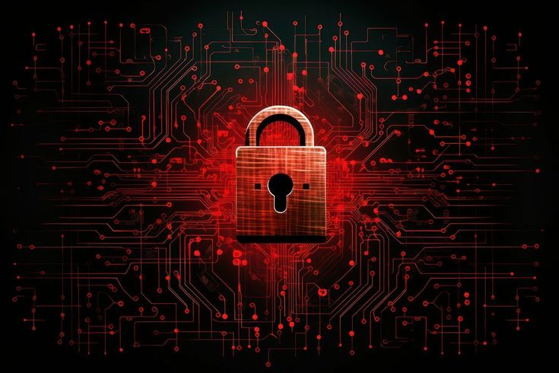
PASSWORD STRENGTH CHECKER
THANK YOU

